Slide 1
GPS for Health
The biggest case since washing hands

Slide 2

Errors in hospitals
Washing hands
... infections
20%
GPS for Health
... medication and procedure errors
5%
0%
1880
2018
Fixing what wasn’t perceived as errors

Slide 3
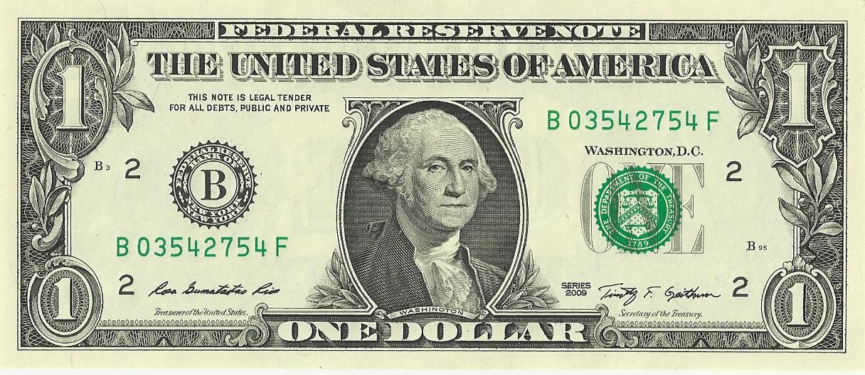
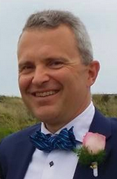
The biggest case since washing hands
Avoid errors.
Global optimum.
People in control.
If it’s free, where’s the money?
Care givers pay for the integration
Why?
Patients require the guarantee
Conformance and avoid double data entry

Slide 4
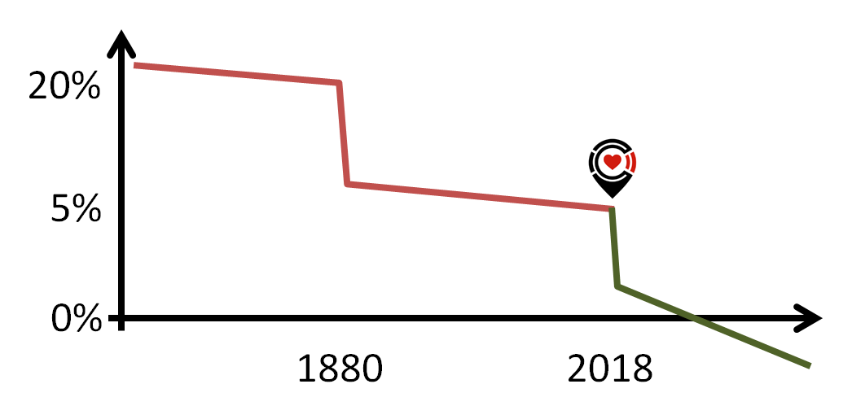
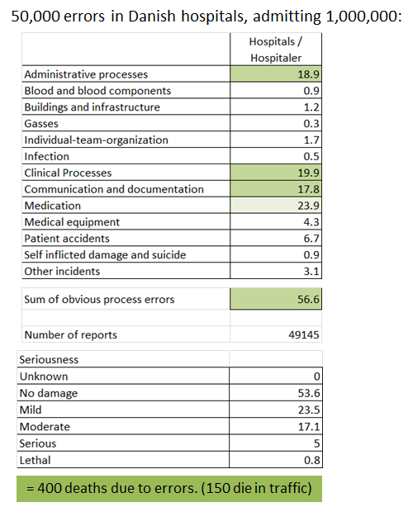
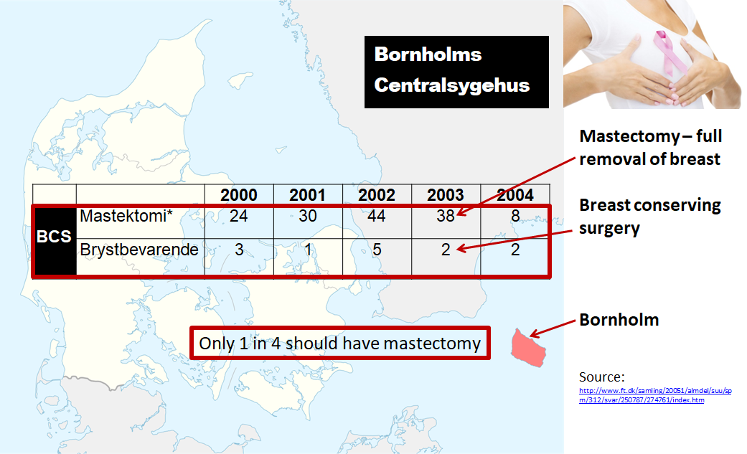
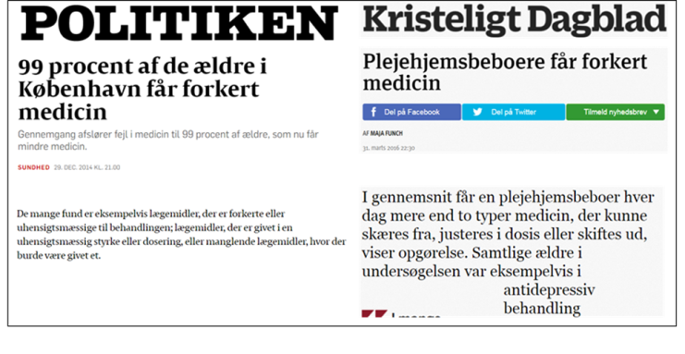
Avoid errors
Avoid errors.
Global optimum.
People in control.
5% of hospitalizations encounter an error
More people die from hospital errors than in traffic
80% of hospital errors
Medication (23.9%)
Procedure (56.6%)
Bad cases of errors of in hospitals
Perception of many medication errors
Procedure
Medication

Slide 5
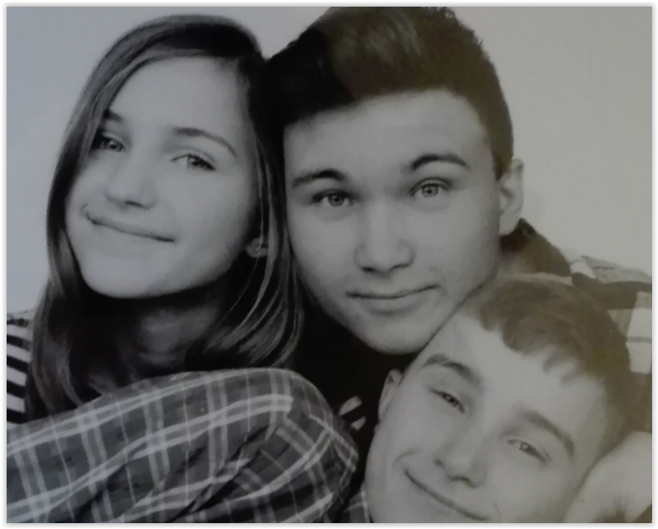
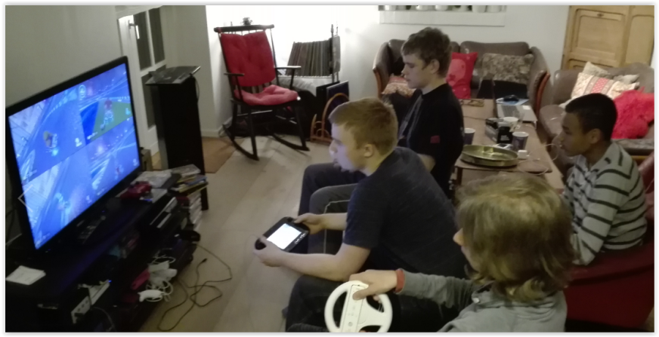
Global optimum
Avoid errors.
Global optimum.
People in control.
Are there Danish guidelines?
Our kids want no such thing as national guidelines. They interact Globally. They want the Global optimum.

Slide 6


People in control Before
Avoid errors.
Global optimum.
People in control.
Doctor
Electronic Health Record
Hospital
Patient

Slide 7

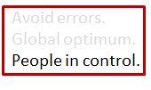

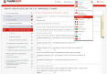
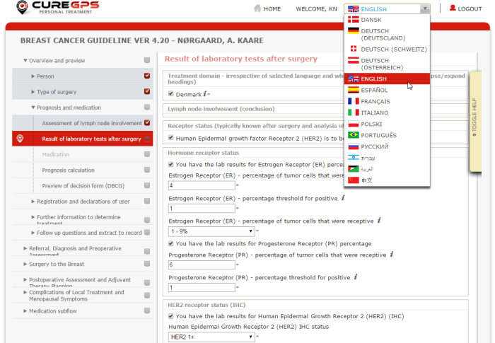
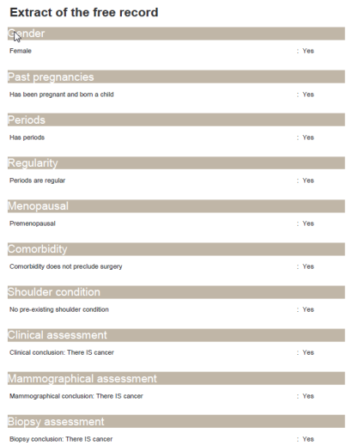
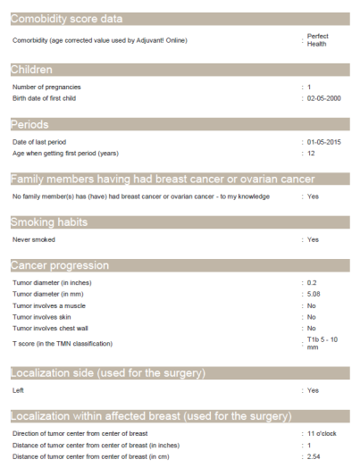
People in control After
Doctor
Patient
Electronic Health Record
Hospital
Prefill of data
CURE GPS
Record
creation / storing
The patient participates in decisons, checks conformance

Slide 8
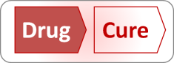
Drug Cure Execution
The biggest case since washing hands

Slide 9








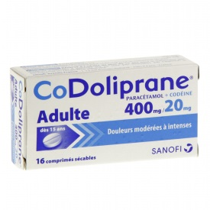
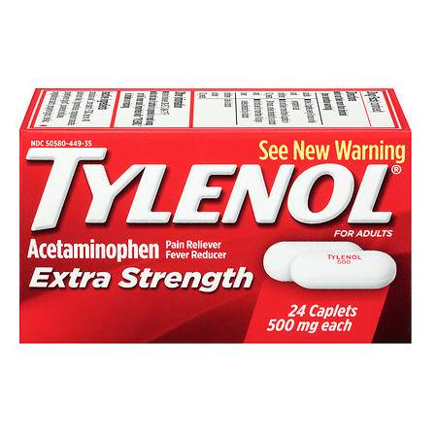
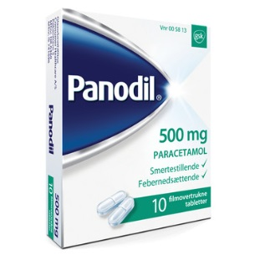
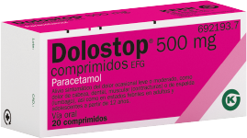


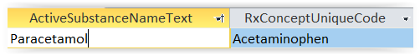
The whole world builds its medicine on the same 1,500 active substances
7,600
Medicines
12,000
Medicines
12,000
Medicines
19,900
Medicines
1,500
Active Substances
Fixed by Rx Norm

Slide 10
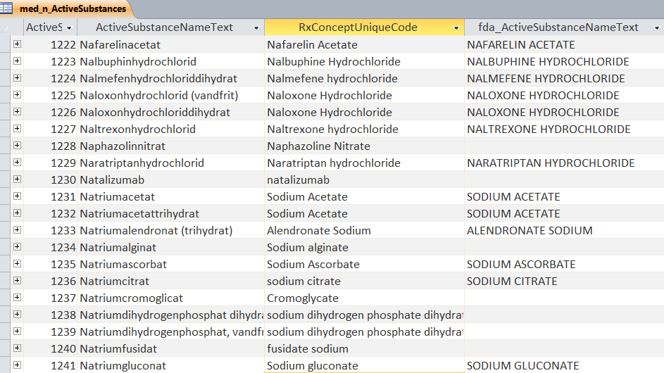
Global substance list – USA
Danish / European
Related to UN through ATC codes
RxNorm (USA)
Unique codes behind
Orange Book (FDA – USA)
Substances shown
1,500
Active Substances
Fixed by Rx Norm

Slide 11
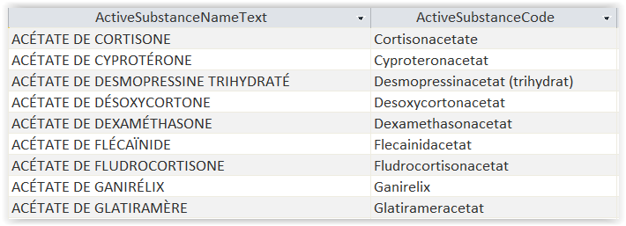
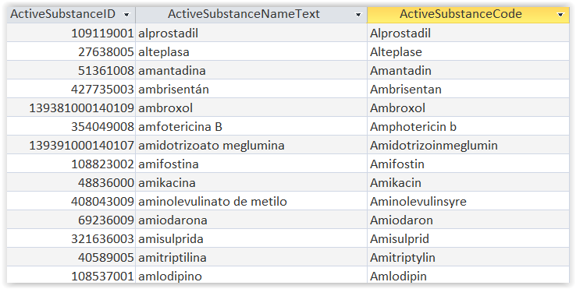
Global substance list – France, Spain
1,500
Active Substances
Fixed by Rx Norm

Slide 12
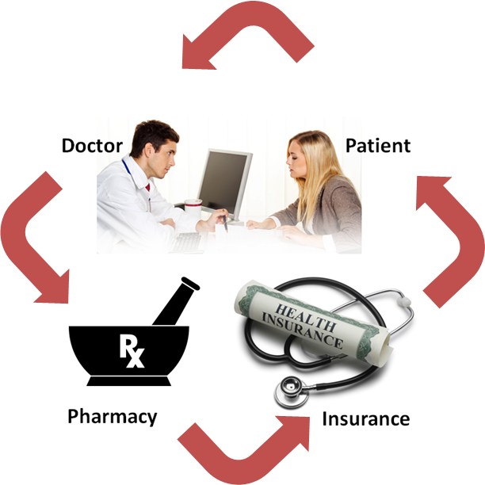

Currently launched
DrugGPS.org
$150 per year per doc
ZocDoc: 50,000 docs
Marketing not started
MedTjek.dk
MedDialog.dk
Common prescriptions database
$150 per year per elderly

Slide 13
Data model for global medication
Medication master data
E.g.:
Prescriptions
Medication Packages
Marevan ( 2.5 mg ) ( 100 Unit of 1 Pill) (Orifarm)
2 x
ATC codes
Warfarin
Medications
Marevan ( 2.5 mg )
DK: 7,600 (940 combi, 12.3%)
Substance Super Classes
7
Anticoagulant
FDA (US): 19,900 (2,550 combi, 12.8%)
Substance Classes
430
Antikoagulantia, perorale [DA]
Substance Groups
2,000
Warfarin
US: 1,300
DK: 1,300
Medication prescribed
Active Substances
Rx Norm
Both: 820
Warfarin sodium
2,750
US: 1,500
DK: 1,600
Both: 880

Slide 14
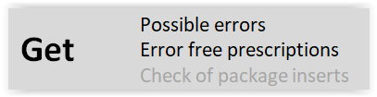
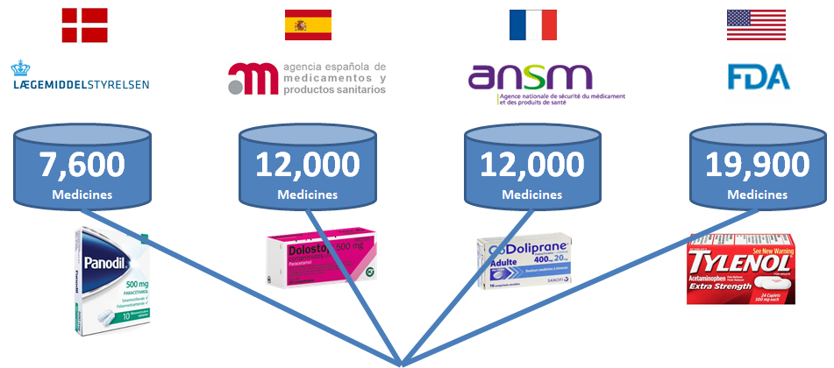
In every country we can find errors. We just need the medication database
Drug allergies
Several substances in the same class (e.g. several anticoagulants or diuretics)
Interactions
Over dosing
Contra indications
Required measurements cf. the medication (GFR, INR, QTc, blood pressure)
1,500
Active Substances

Slide 15
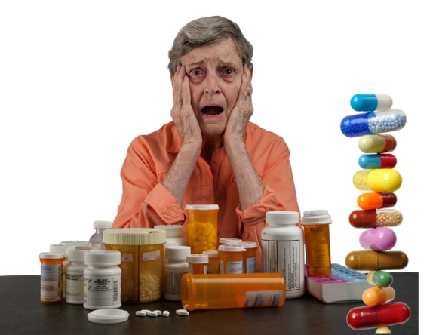
6 in 8 of people consuming more than 10 drugs have medication errors

Slide 16

Digitized package inserts
Statins
Simvastatin
Atorvastatin
Rosuvastatin
Blood pressure medication
Enalapril (ACE inhibitor)
Losartan (angiotensin II-receptor antagonist)
Thyroid hormons
Levothyroxine
Proton pumps
Esomeprazole
Inhalators
Albuterol (Salbutamol)
Fluticasone
Salmeterol
Tiotropium
Insulin
1,500
Active Substances
Fixed by Rx Norm
Based on Active Substances

Slide 17
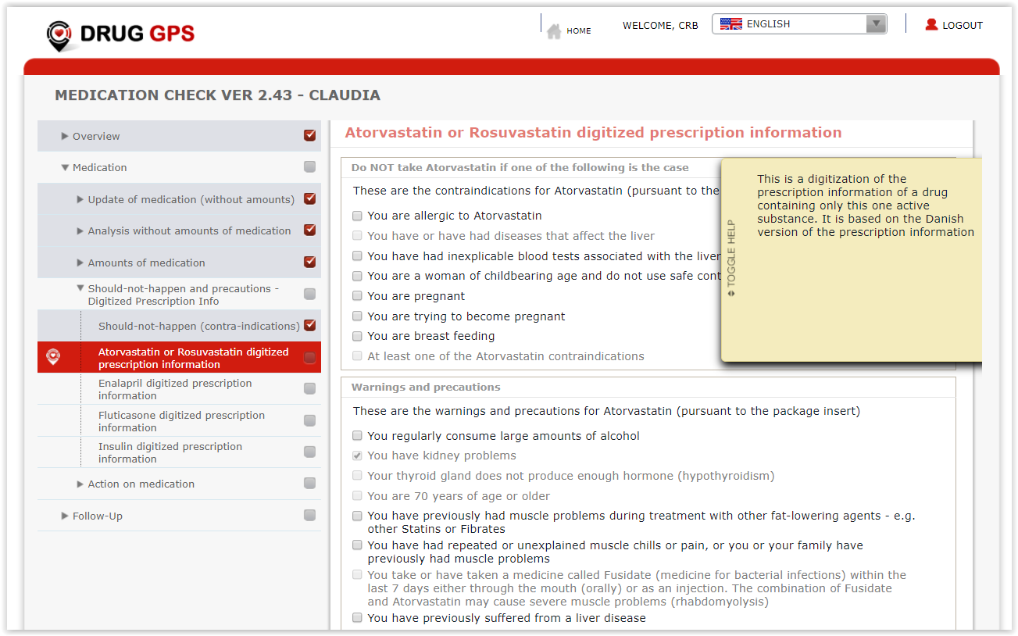
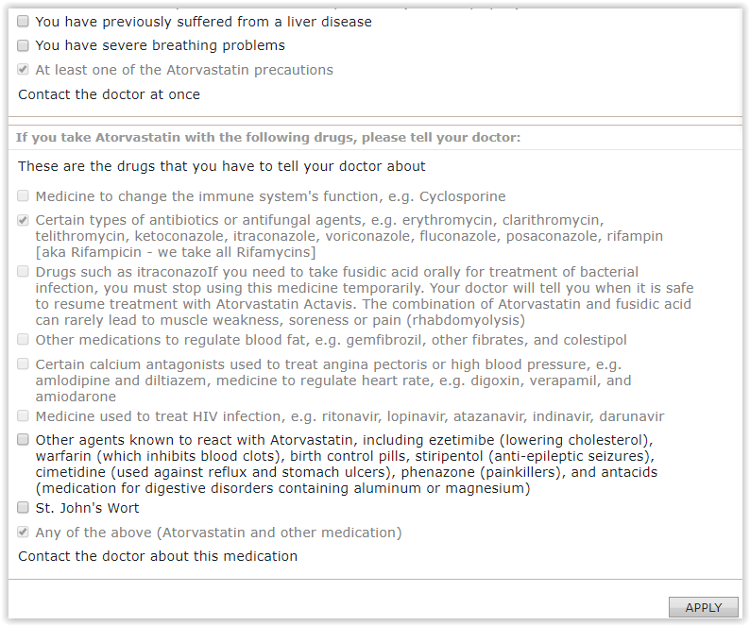
Rosuvastatin package insert
Statins
Simvastatin
Atorvastatin
Rosuvastatin
Blood pressure medication
Enalapril
Losartan
Thyroid hormons
Levo-thyroxine
Proton pumps
Esome-prazole
Inhalators
Albuterol (Salbutamol)
Fluticasone
Salmeterol
Tiotropium
Insulin
It asks these questions if package inserts require that info ... And only to women less than 51

Slide 18
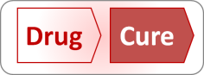
Drug Cure Execution
The biggest case since washing hands

Slide 19
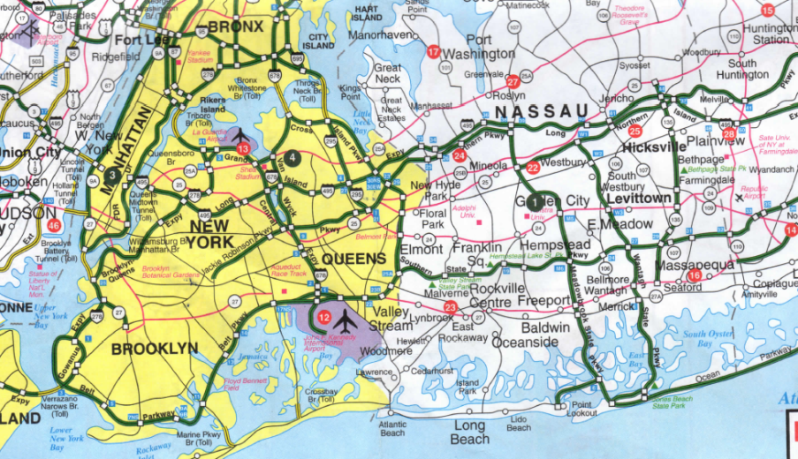
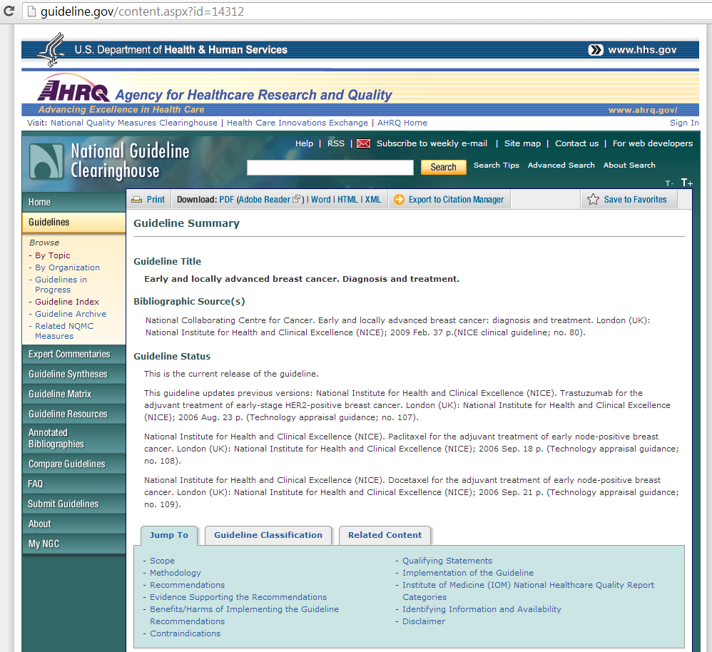
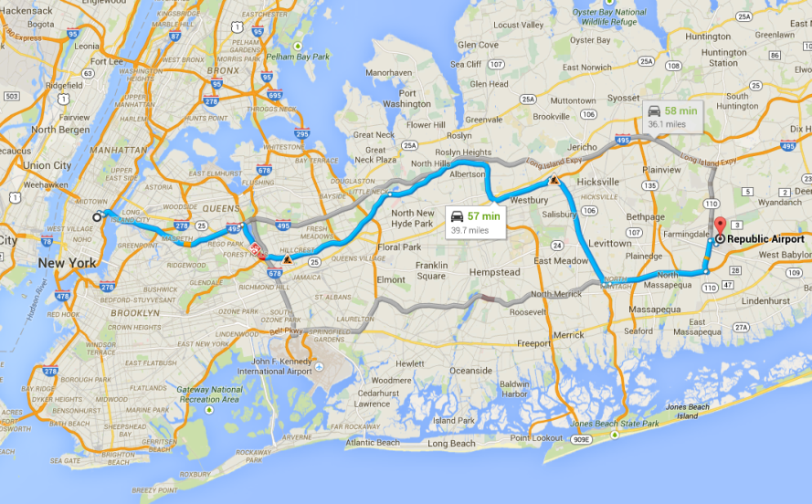
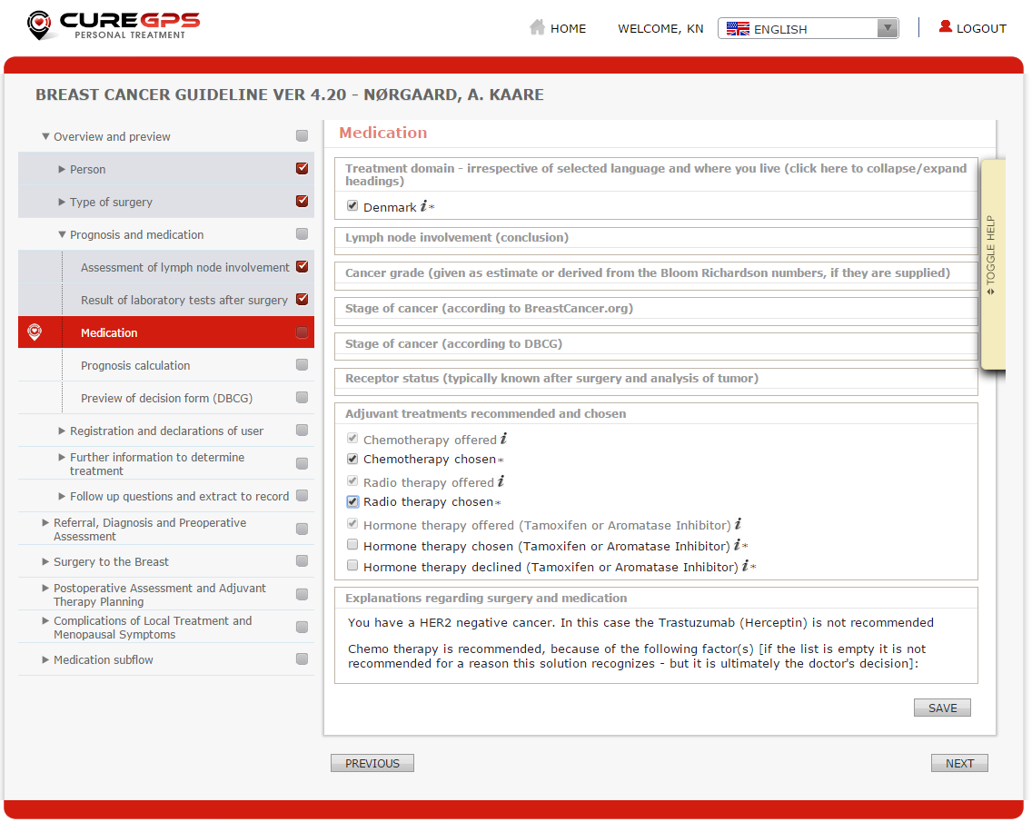
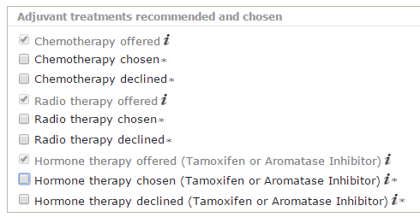
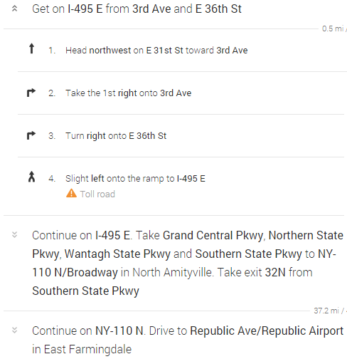
Same as the GPS when driving from A to B: Routing through a treatment to the cure
Digital map
Digital guide-line
GPS
Cure GPS

Slide 20
Diagnosis + Project = Treatment
Project
Treatment
Many steps & actors
Solution
Project Plan
Process Matrix
Approval
Diagnosis
Few steps & actors
Flow Chart
Artificial Intelligence
Simple rules, few variants
Complex rules, many variants
Problem

Slide 21
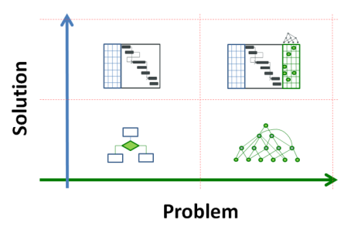
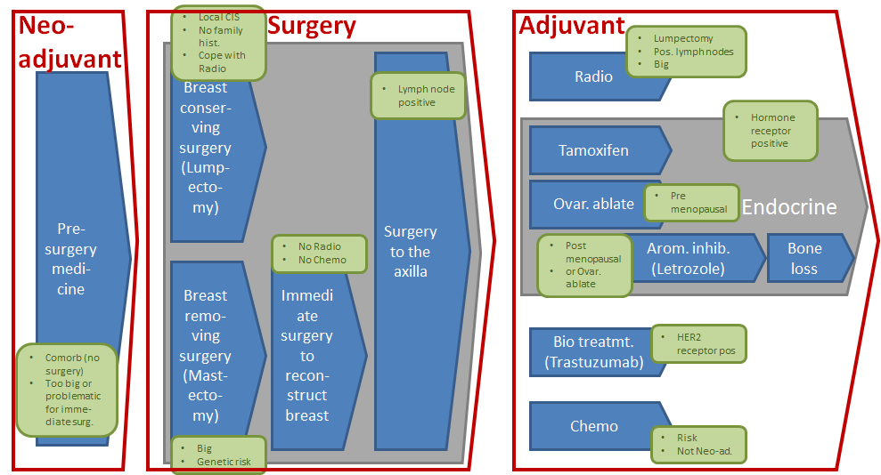

Variant explosion. Moving target
The 300 variant conditions that may change or be uncvered as you go – examples:
Woman or Man
Menopausal
Pregnant
Young/old
Had radiation in past
Family (genetic) risk
Drug allergies
Preferences
Cancer big/small
Single/multiple
Invasive
Ductal/lobular
Grade 1, 2, 3
ER positive
HER2 positive
Lymph nodes hit
Unlimited variants. 2³⁰⁰ breast cancer treatments
Project plan
Problem changes during solution

Slide 22
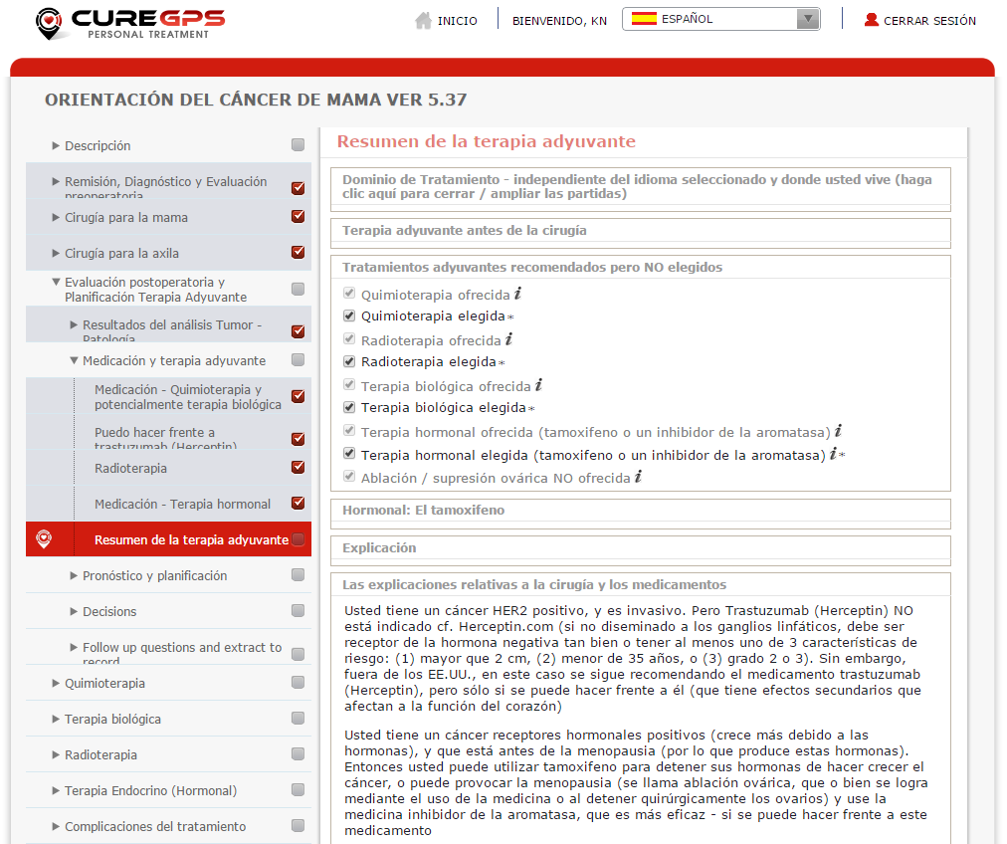
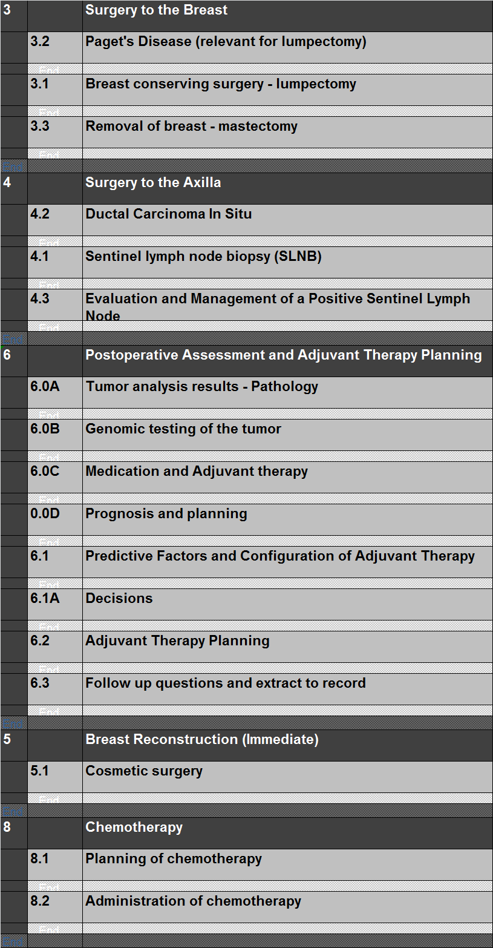
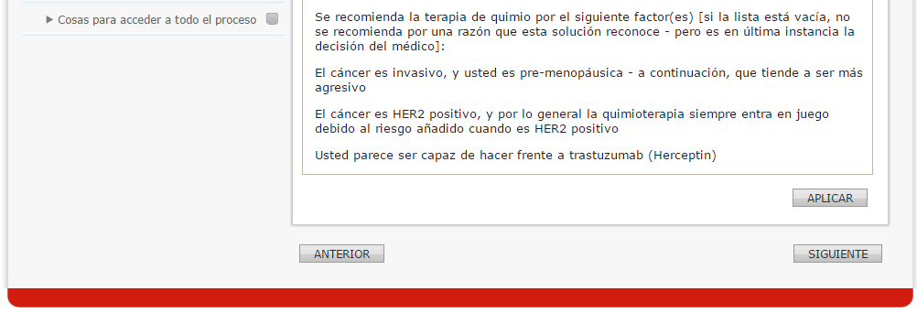
Data driven, auto generated (1)
[Extract from Excel based designer]

Slide 23
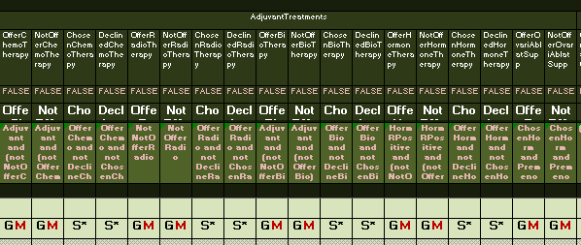
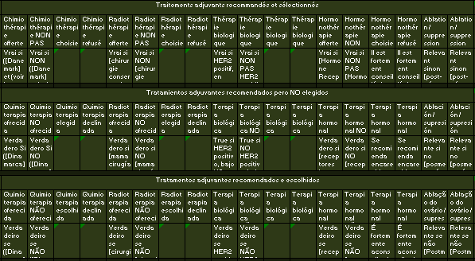
Data driven, auto generated (2)
Relevance rules. Irrelevant data variables are hidden
[Extract from Excel based designer]
These letters determine which data elements come onto which steps. Whether the variable is read-only on this step, required, whether the step must reset, if the variable changes value, and much more

Slide 24
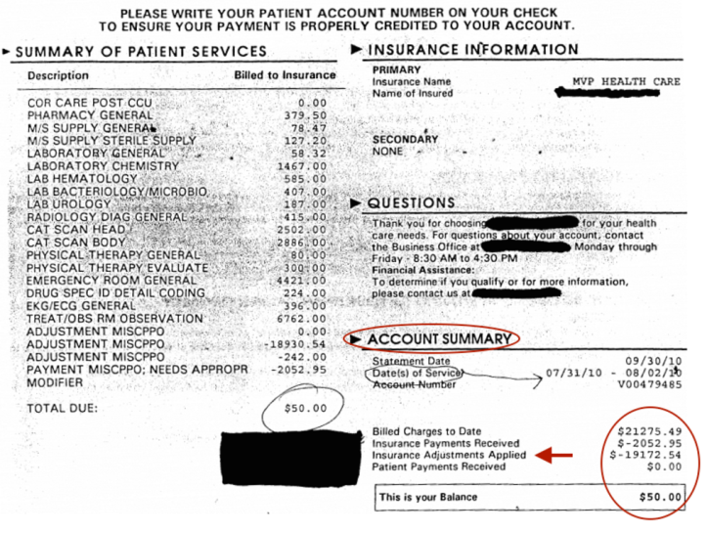


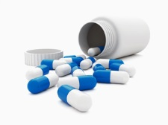
We start with breast cancer in the USA: Reducing cost for Health Insurance
250,000 new breast cancers / year
$125,000+ per patient (hospital and drugs)
Hospitals spend 1 – 5% of revenue on malpractice (insurance)
Hospitals bill 4 times what they recover (*)
Ongoing fight to settle
Bills are ”fuzzy” and contain unnecessary items
Our solution
Avoids malpractice and documents it
Controls the cost
Gives an ”optimality guarantee”: Treated conformant to rules
Example of hospital bill (*)
(*) Source: TrueCostOfHealthcare.net
Hospitals
Health Insurers
Initial business case
$1,000 per patient for lowering $125,000 of cost
Patients get ”optimal treatment guarantee” and ”reimbursement guarantee”
And patients love the insights...
$25k
Pharmaceuticals
$100k
$125k

Slide 25
Drug Cure Execution
The biggest case since washing hands

Slide 26
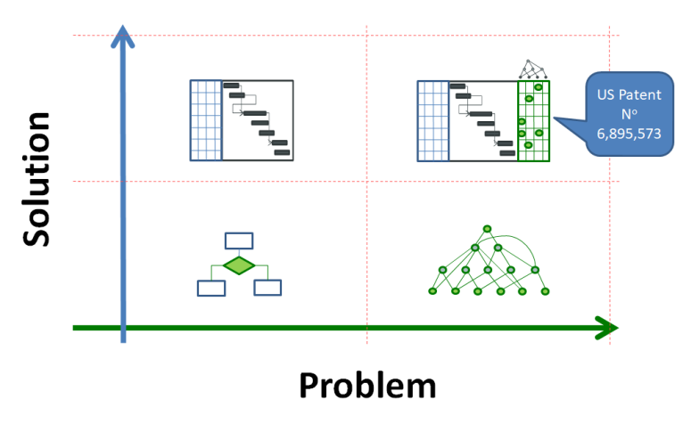
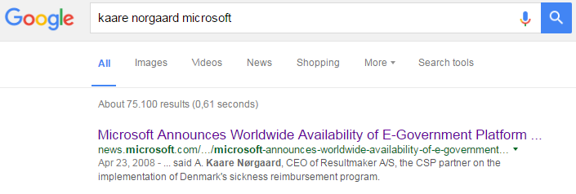
History
Unique, patented idea
Workflow = Project execution
1st generation
Resultmaker: e-Government
Virk.dk – from IBM
Sick Reimbursemt: Largest e-Govt
Car inspection
All Danish ministries except Defence
Microsoft e-Gov Partner #1
2nd generation
KnowGo (Mauritius, France)
Cph. Biz School
Ocean Process
Cph. University: ”Booking.com”
Lyngby-Taarbæk: COPD

Slide 27
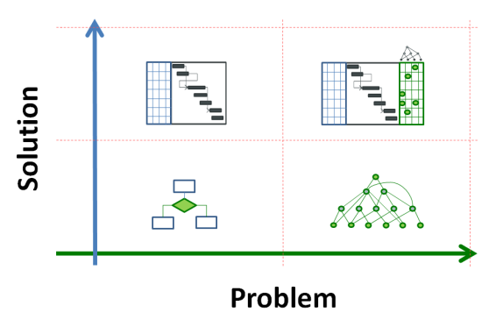
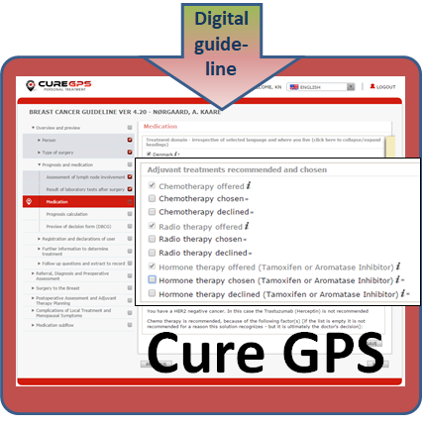

GPS for Health: Drug + Cure management
Drug
Cure
Disease
Cured
Unique Software
Breast Cancer Solution
Global Medication Database
1,500
Active Substances
Personal Health Record
Drug GPS

Slide 28
Income
If it’s free, where’s the money?
Drug
Cure
Care givers pay for the integration
Doctors
Elderly care
Med. databases
Pharma sales
Hospitals
Attraction
Malpractices (1-5%)
Invoicing (75%)
$1k of $125k+
Pharma sales (treatments in stead of drugs)
Why?
Patients require the guarantee
Conformance and avoid double data entry

Slide 29
Profit and loss
Income
Cost
Drug:
$360 per doctor per year
20% of ZocDoc’s 50,000 doctors
$1.8m per year
$150 per elderly per year
Medical databases
Pharma sales
Cure:
$1,000 per treatment
Starting with breast cancer
10% of 250,000 / yr in USA
$25m per year
A share of Pharma Sales
Treatments with guaranteed medication
Technical team
Support and operations
Product development
Mobile. Drop down
Picture of med.s -> med list
Integrations
CE, HIPAA conformance. Anonymity
Clinical team
Medication databases
Guideline digitization
Government agency relations
Sales & Marketing
Partners: Medication record adoption
Hospitals and insurance
Pharmaceuticals
Global clinical community

Slide 30
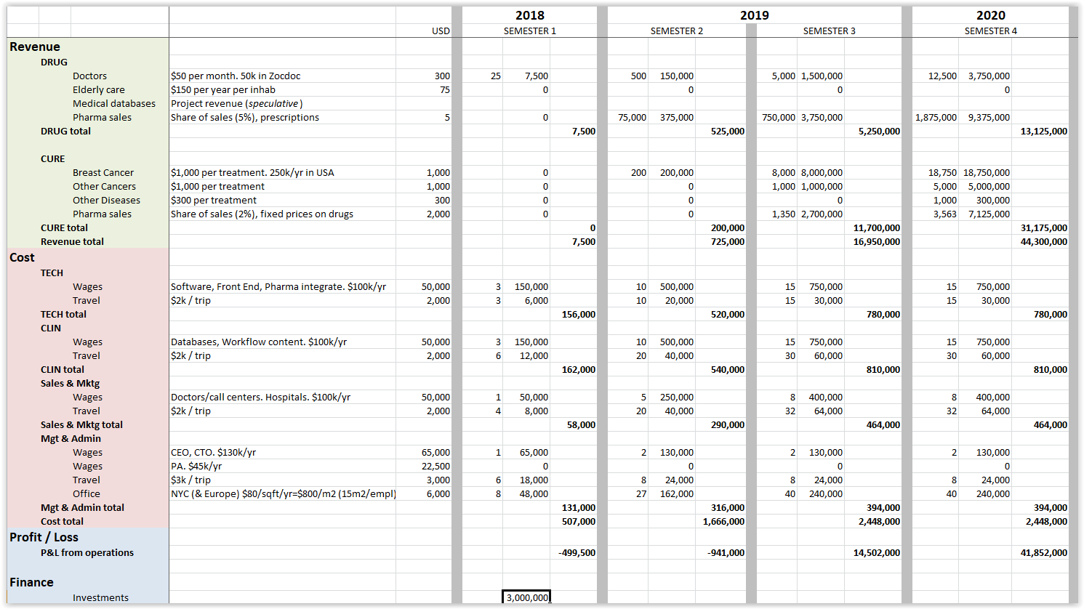
P&L and investment calculation

